Slide 1
DIR-600L
Wireless N150 Home Router
Sales Guide
November 18th 2011
D-Link HQ

Slide 2

Agenda
Sales Keys
  Connect Anytime, Anywhere
  Push Event – Online User Notice
  Push Event – Wireless Intrusion Alert
  User Control
  Real-time Browsing Record
  Easy Setup Wizard
Product Features

Slide 3

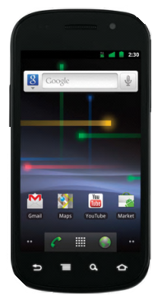

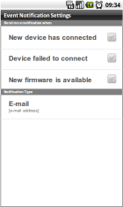
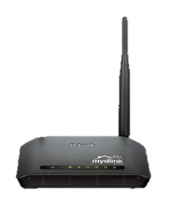






connect anytime, anywhere
Your home router is no longer unreachable !
Wherever you go, you can always use
smartphone App* to receive your family status
from cloud router!
INTERNET
*Currently DIR-605L supports android App and iPhone App.

Slide 4
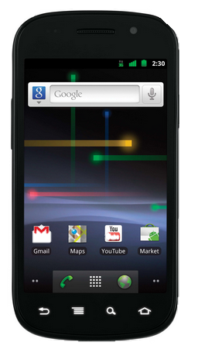
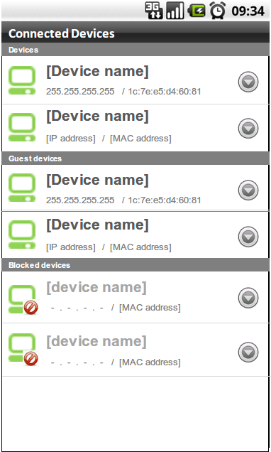




push event – online user notice
Hello!
I am back!
When your kids come back home and go online, the cloud router will send out a reminder to you.
With cloud service, now you can see everyone’s status!
[DD’s iPhone]
192.168.101.2 / 1c:7e:e4:d4:53:90
[KK’s iPhone]
192.168.101.4 / 1c:8e:e4:d4:53:90
[JJWIN7]
192.168.101.5 / 1c:8e:e4:d4:53:83
[TTWINXP]
192.168.101.5 / 1c:7e:e4:d4:53:83
[CCWINXP]
192.168.101.8 / 1c:8e:e4:d4:53:12
[PPWINXP]
192.168.101.9 / 1c:8e:e4:d4:53:11

Slide 5




push event – anti-wireless intrusion
Do you want to block this intruder?
Intrusion happen all the time !
Cloud router can detect and block the unwelcomed guests who intend to keep cracking wireless network.
Any suspect will be displayed on your phone!
[DD’s iPhone]
192.168.101.2 / 1c:7e:e4:d4:53:90
[KK’s iPhone]
192.168.101.4 / 1c:8e:e4:d4:53:90
[JJWIN7]
192.168.101.5 / 1c:8e:e4:d4:53:83
[TTWINXP]
Block it!
192.168.101.5 / 1c:7e:e4:d4:53:83
You’re banned!
[CCWINXP]
192.168.101.8 / 1c:8e:e4:d4:53:12
[PPWINXP]
192.168.101.9 / 1c:8e:e4:d4:53:11

Slide 6



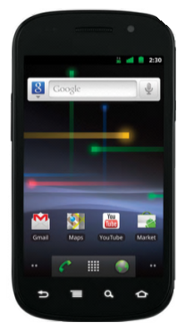

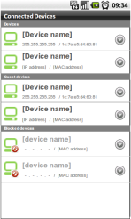



user control
It’s time to take a rest? Don’t let your home
member get addicted to net surfing !
Cloud router can monitor and manage
your network client.
INTERNET
Smartphone App
Remote control your network clients

Slide 7
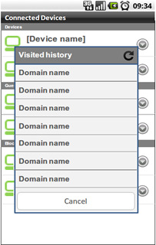


Real-time browsing record
Only One Click!
Cloud router can monitor the activity of your children net surfing!
The real-time browsing history can easily list recent website record without any trace!
[DD’s iPhone]
www.dlink.com
www.dlink.com/cat
news.google.com
www.facebook.com
Website Scanning…
www.nytimes.com/
www.bcc.co.uk
tw. mydlink.com

Slide 8
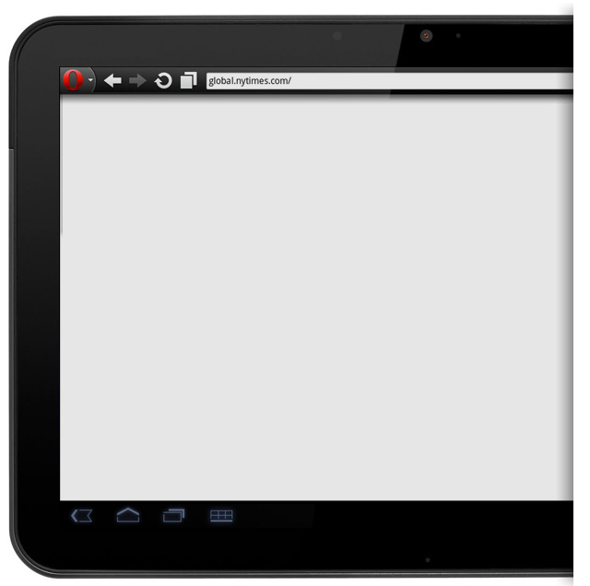
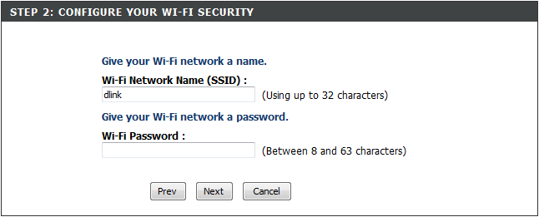






Easy setup wizard
Just Open Browser and Start Setup !
More and more PAD and Smart phone.
Less and less Ethernet support.
Any device would just work!
Handheld devices, PC and Mac.
So easy! Setup in just a few clicks.
  Auto Detection
  Wireless Setup
  Access INTERNET
  mydlink service

Slide 9






Product feature
MIMO feature supported delivering PHY rates up to 150 Mbps
IEEE 802.11n standard certified and compatible to legacy IEEE802.11b/g
Supports WMM function to meet the multimedia data bandwidth requirement
Wi-Fi Protected Setup (WPS)
WEP and WPA/WPA2 (TKIP and AES) data encryption
Android/iPhone App Support for mydlink service
  Push Event for Wireless Intrusion
  Push Event for Online User Notice
  Push Event for FW Upgrade
  User Control – Access Control
  User Control - Real-time Browsing Record
CAPTCHA (Graphic Authentication)
Easy Setup Wizard for Installing Router and mydlink Service
Traffic Control
WDS + AP feature

Slide 10
Thank you!

